Slide 1
Motif discovery for WhiH

Slide 2
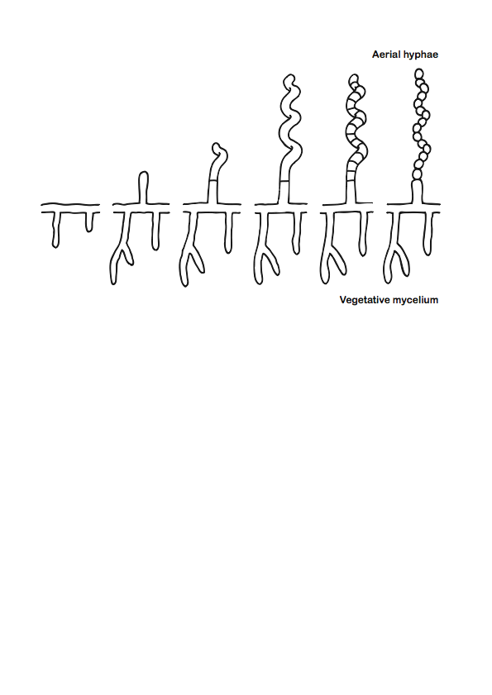
Sporulation in Streptomyces

Slide 3
whiH mutants are defective in septation
Colony appearance
Sporulating aerial hyphae
WT
whiH⁻
WT
whiH⁻

Slide 4
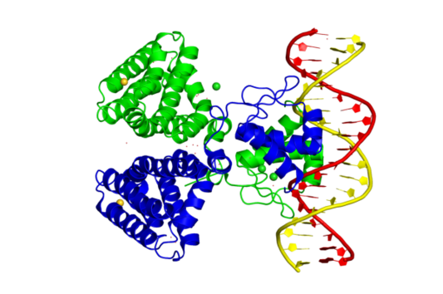
WhiH is a FadR-like transcription factor
E. coli FadR dimer bound to DNA
www.ebi.ac.uk/pdbe-srv/view/entry/1h9t/summary

